Slide 1


Classifying Fake/Real Job Posting And Job Recommender
IST 707 Applied Machine Learning
Final Project Presentation
By Dishank Solanki
1

Slide 2

Table of contents
Problem set description
Objectives of the project
Initial Data Exploration
Data Analysis via visualizations
ML Models & their performances
Job Recommendation system
2

Slide 3

Problem Statement
New graduate students are very excited to start their career.
Pandemic has reduced job opportunities.
This makes appropriate opportunity for scammers
My friend has been victim of such scam
According to CNBC, job scams has doubled in 2018 compared to 2017
3

Slide 4
Objectives
Analyse
Analyse various aspect of job market to understand the behaviour of job scammers.
Build
Build the ML model to classify the job postings
Build
Build Recommendation system to recommend jobs using cosine similarity
4

Slide 5

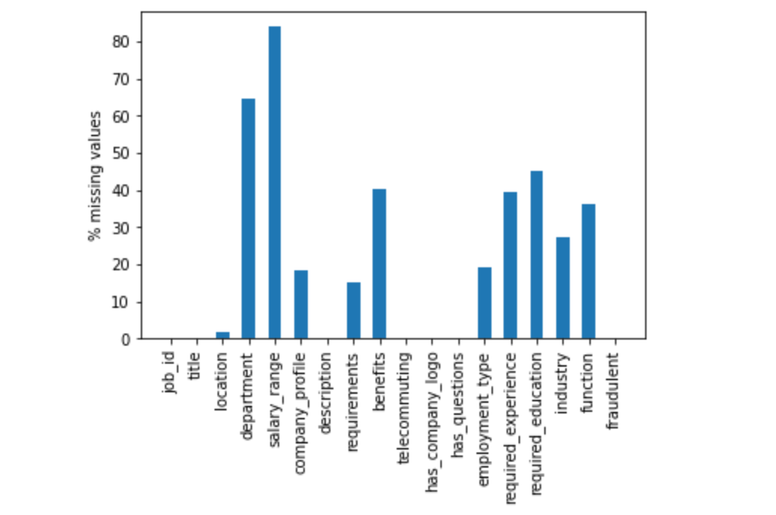
Initial Data Exploration
Dataset Shape = 17880,18
Data types = 5 numeric(3 are binary columns) and 10 string
Target Variable = Fraudulent
% missing values in each column
5

Slide 6
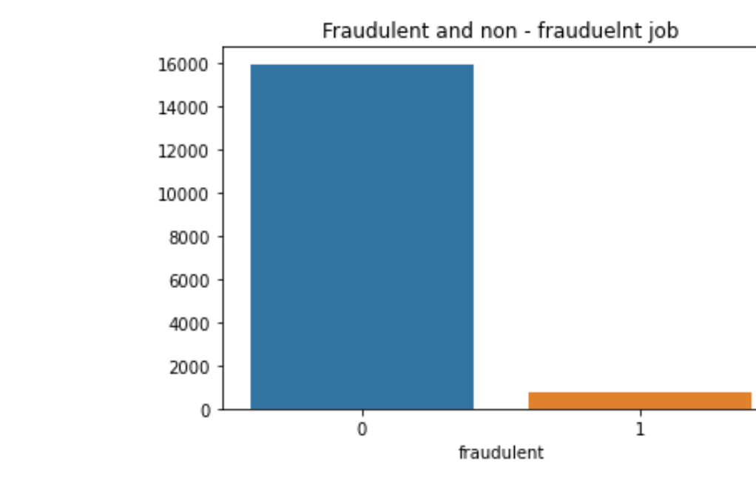
Data Cleaning
Remove the features which has more than 50% of missing values (Salary_range, department)
Remove rows which has more that 50% of missing values(used dropna(thresh = 6))
Remove Id column as pandas dataframe have row numbers
Split the Location Column to extract Country Name
Final Dataset – 16712 , 15
Missing Values – “Not mentioned” used for EDA and “ ” for models.
6

Slide 7
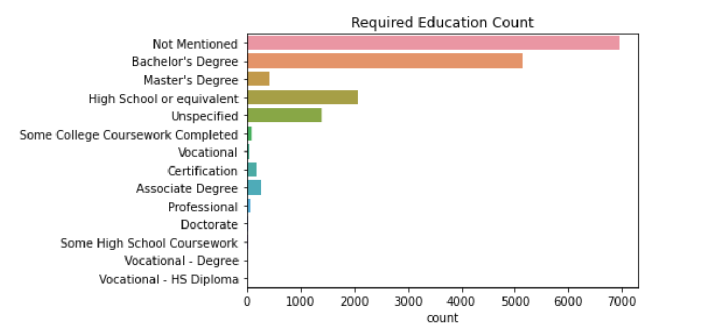
Job posted Visualizations
Most Common Required Education For Posted Jobs
7

Slide 8
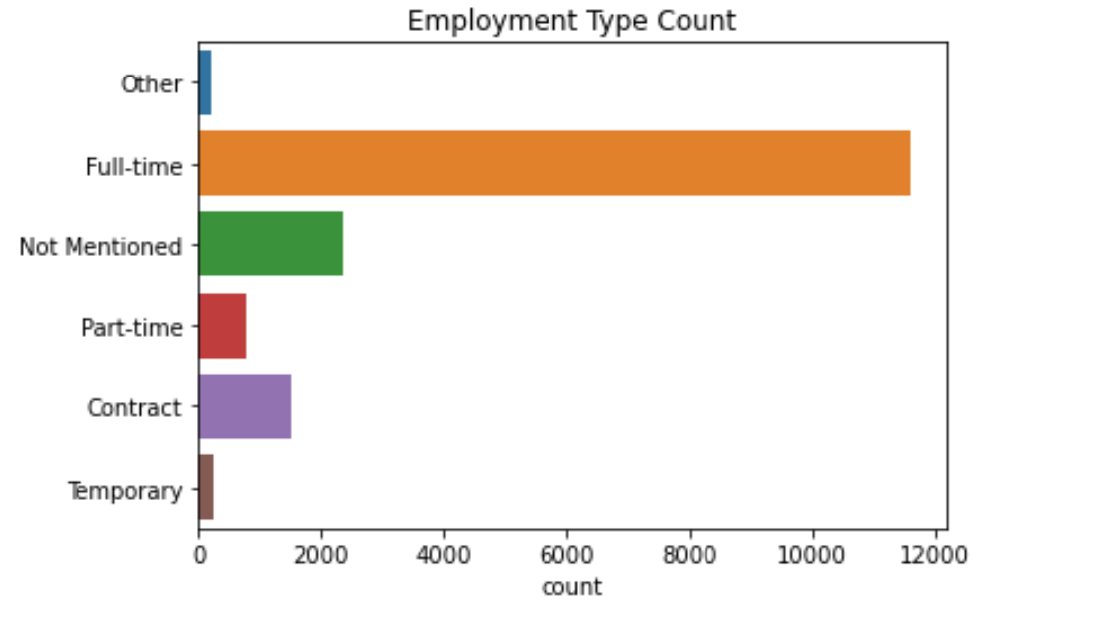
Job posted Visualizations
Most Common Employment Type For Job Posted
8

Slide 9
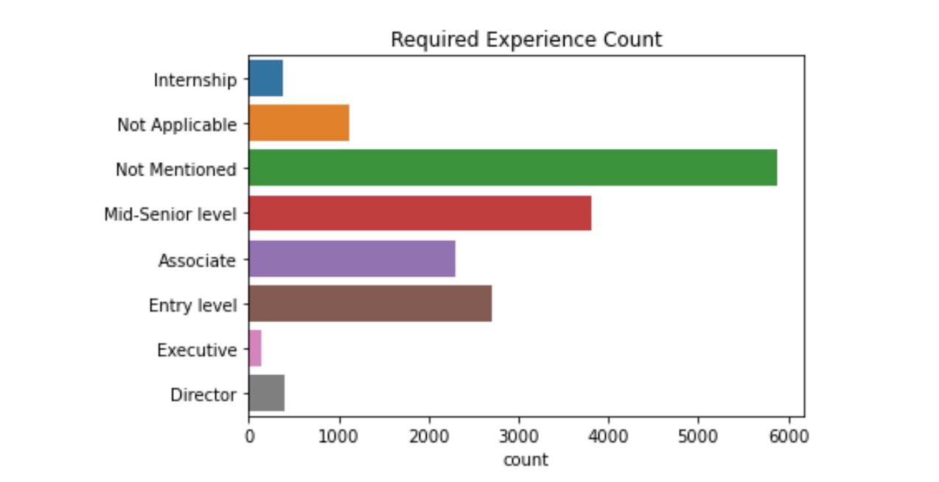
Job posted Visualizations
Required Experience For Posted Jobs
9

Slide 10
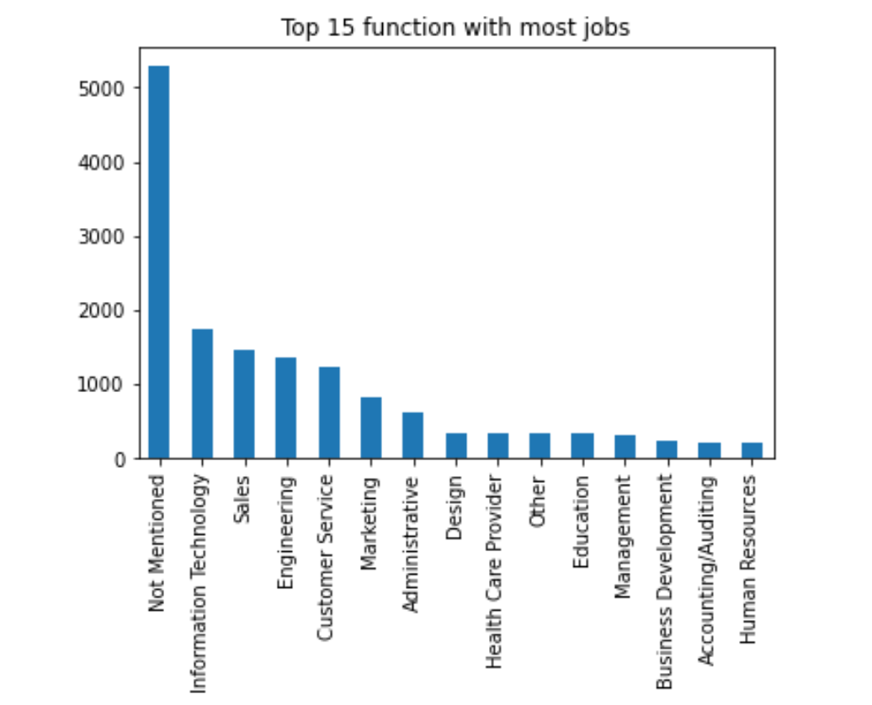
Job Posted Visualizations
Top 15 Function with most jobs
10

Slide 11
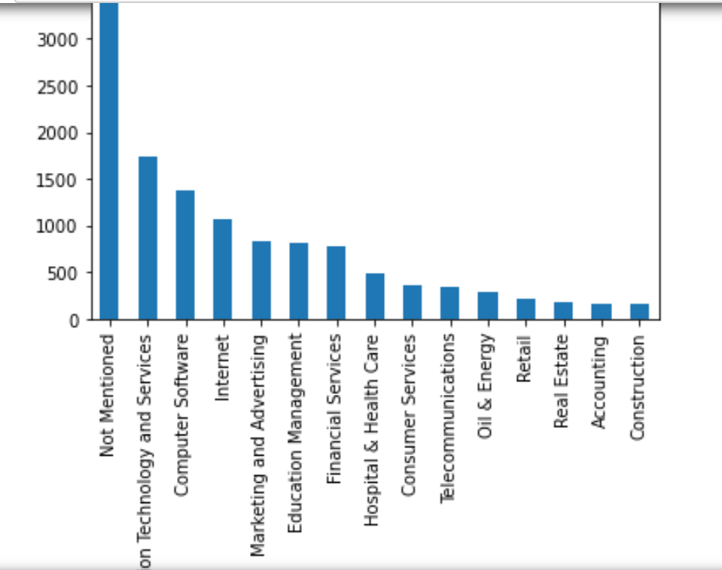
Job Posted Visualizations
Top 15 Industry with most jobs
11

Slide 12
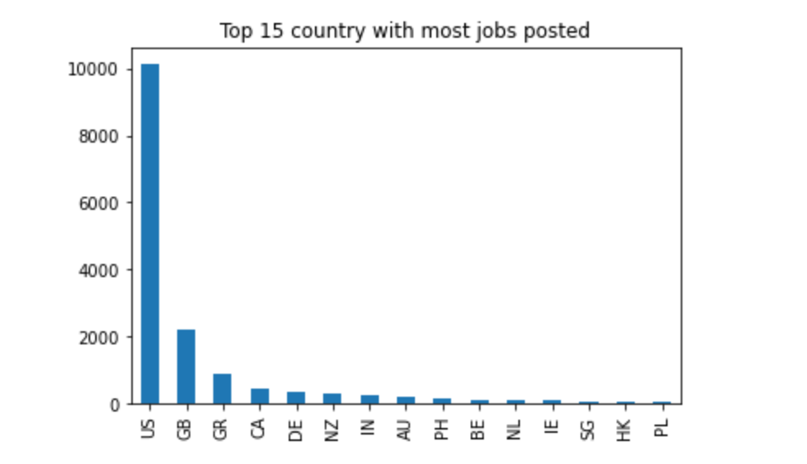
Job Posted Visualizations
Top Country with most jobs posted
12

Slide 13
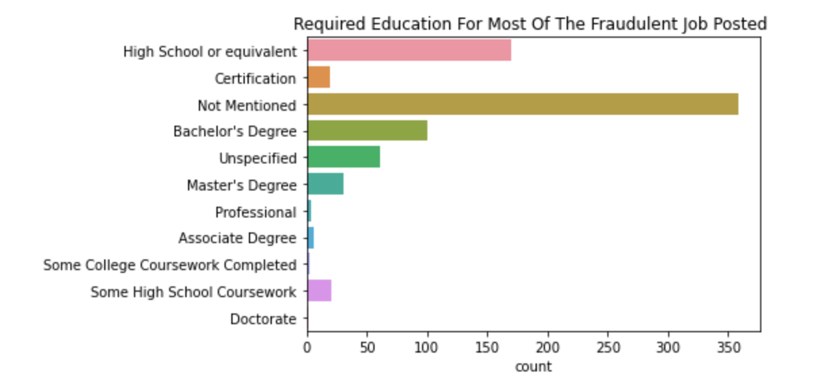
Fraudulent Job posted Visualizations
Most Common Required Education For Fraudulent Posted Jobs
13

Slide 14
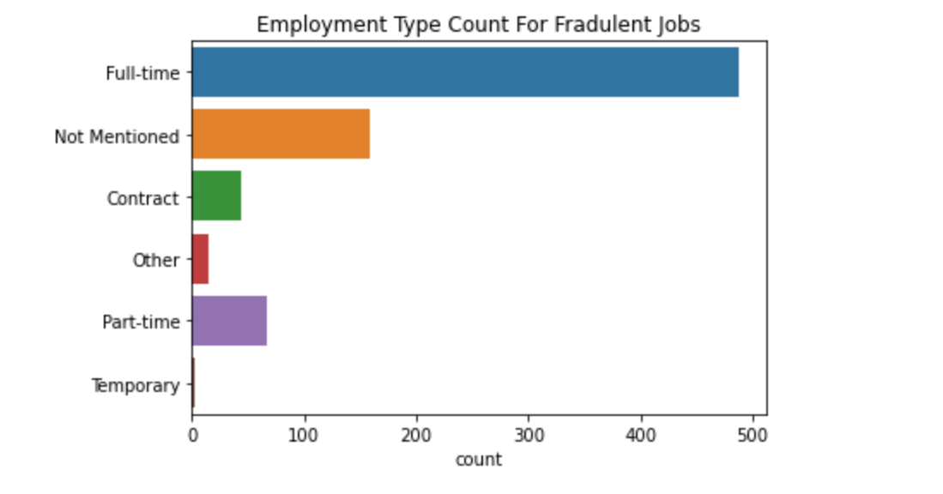
Fraudulent Job posted Visualizations
Most Common Employment Type For Job Posted
14

Slide 15
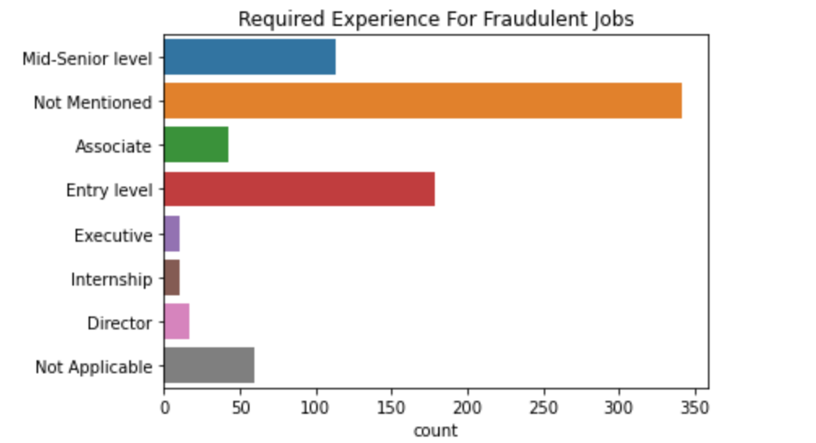
Fraudulent Job posted Visualizations
Required Experience For Fraudulent Job Posted
15

Slide 16
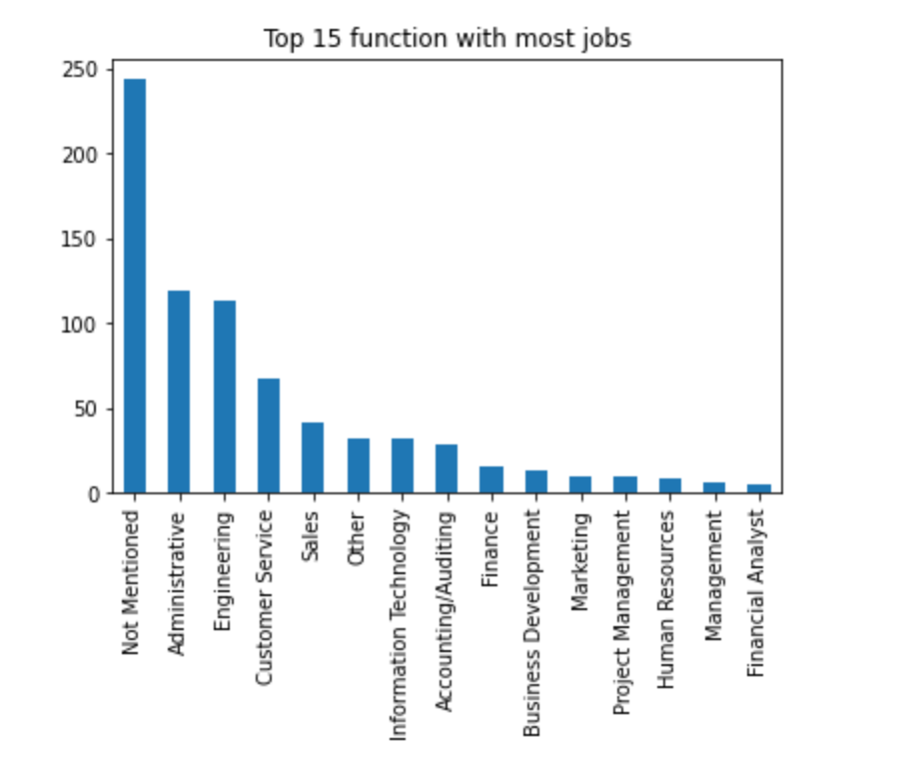
Fraudulent Job Posted Visualizations
Top 15 Function with most jobs
16

Slide 17
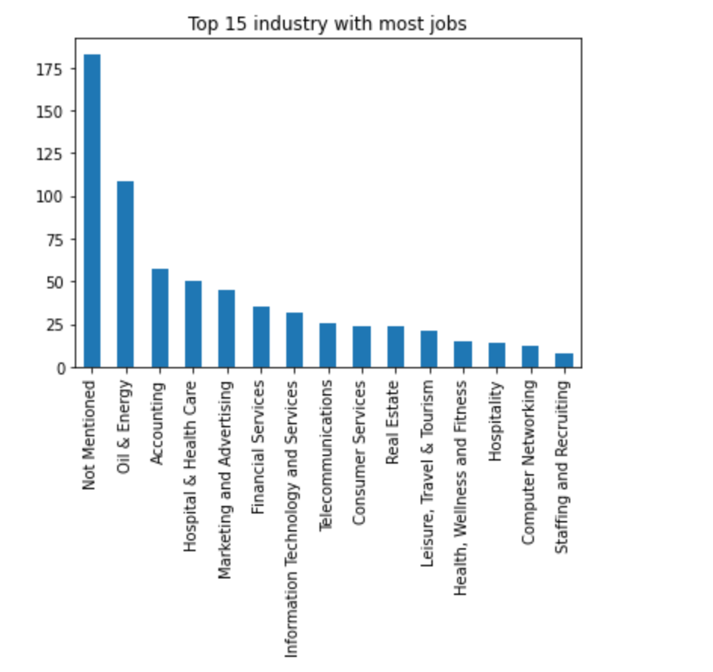
Fraudulent Job Posted Visualizations
Top 15 Industry with most jobs
17

Slide 18
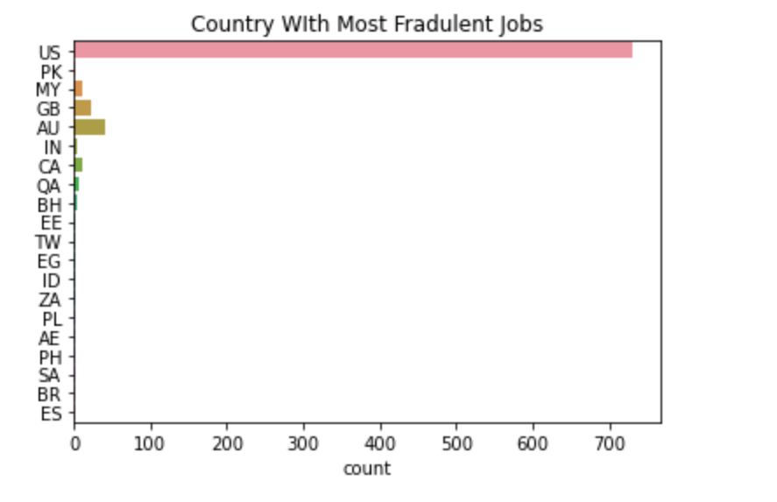
Fraudulent Job Posted Visualizations
Top Country With Most Fraudulent Job Posted
18

Slide 19
Exploratory Data Analysis Summary
Parameters | Overall Job Posting | Fraudulent Job Posting
Employment Type In Job | Full - Time | Full - Time
Education Required In Job | Bachelors Degree | High School or Equivalent
Experience Required In Job | Mid – Senior Level | Entry - Level
Industry | Information Technology & Services | Oil & Energy
Function | Information Technology | Administrative
Country | USA | USA
19

Slide 20

Preprocessing
Randomly choose 1227 rows out of non-fraudulent dataset (to remove inequality)
Total 2000 rows used to build the model
Merged all the textual columns
Use of tokenization, stopwords and TDIDF transformation
Train – Test split: 75-25
20

Slide 21
Models and it’s best parameters (CV = 7) | AUC (test) | Accuracy (test)
Logistic Regression (C= 10, penalty= l2) | 0.98 | 0.95
Multinomial Naïve Bayes (alpha = 0.01) | 0.96 | 0.90
SVM (c=1, gamma = 0.1, kernel = linear) |  | 0.94
Decision Tree Classifier (criterion = gini, max_depth = 9, max_leaf_nodes = 9) | 0.84 | 0.79
Random Forest Classifier (bootstrap = False, max_depth = 20, min_samples_leaf = 5, min_samples_split = 15) | 0.97 | 0.89
Models & Their Performance
21

Slide 22
Recommendation System
Job Recommendation System using Cosine similarity(Based on Title, employment type, location and Industry)
Use Cosine Simalirity to calculate the distance between title
Collect above mentioned data from user
Employment Type, Location are used as filters
Used TFIDF to convert Title and Function into vector
Recommend 10 job
22

Slide 23
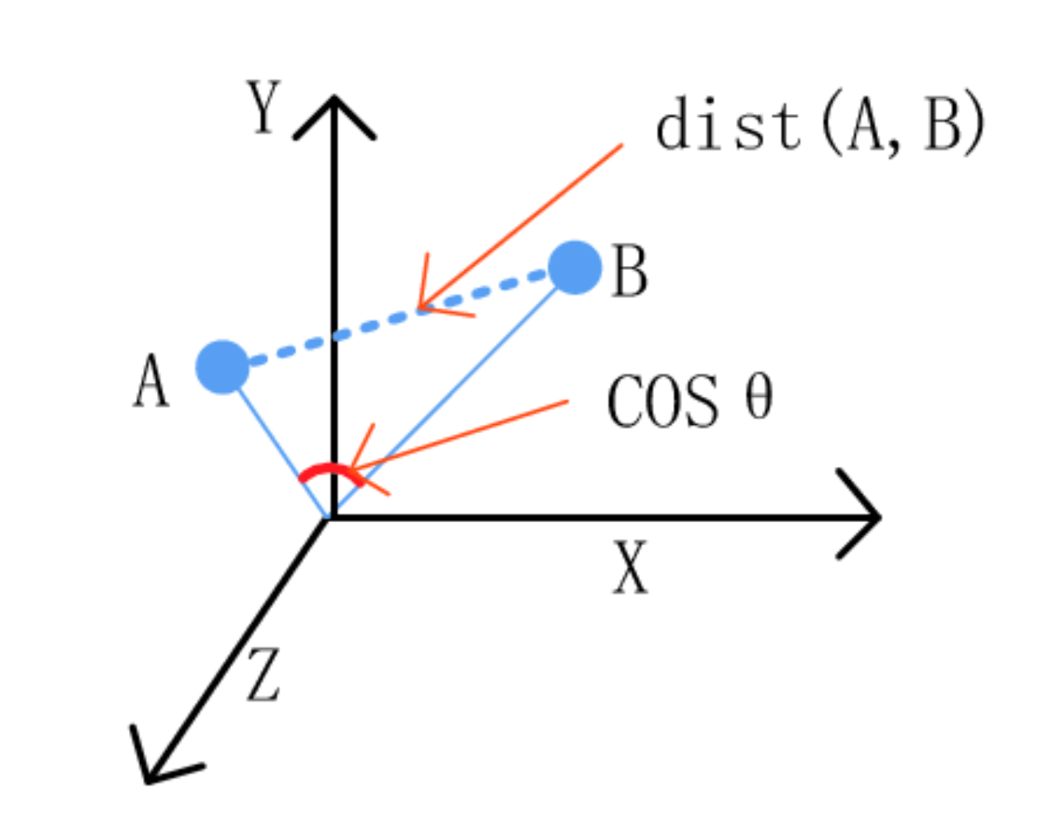
Cosine Similarity Basic
Two title+Function are expressed as vector
If vectors are parallel(angle = 0) => cos(0) = 1 which means two vectors are similar
If Vectors are perpendicular (angle = 90) => cos(90) = 0 which means they are not similar
23

Slide 24
Recommendation System Results
Input
Top 10 Cosine Similarities
Index | Cosine Similarity
2400 | 0.61
1559 | 0.57
6023 | 0.52
5598 | 0.45
2843 | 0.43
4498 | 0.33
2996 | 0.33
809 | 0.31
352 | 0.30
Enter Country: United States
Enter Employment Type: Full-time
Enter Title: Software
Enter Function: Engineering
24

Slide 25
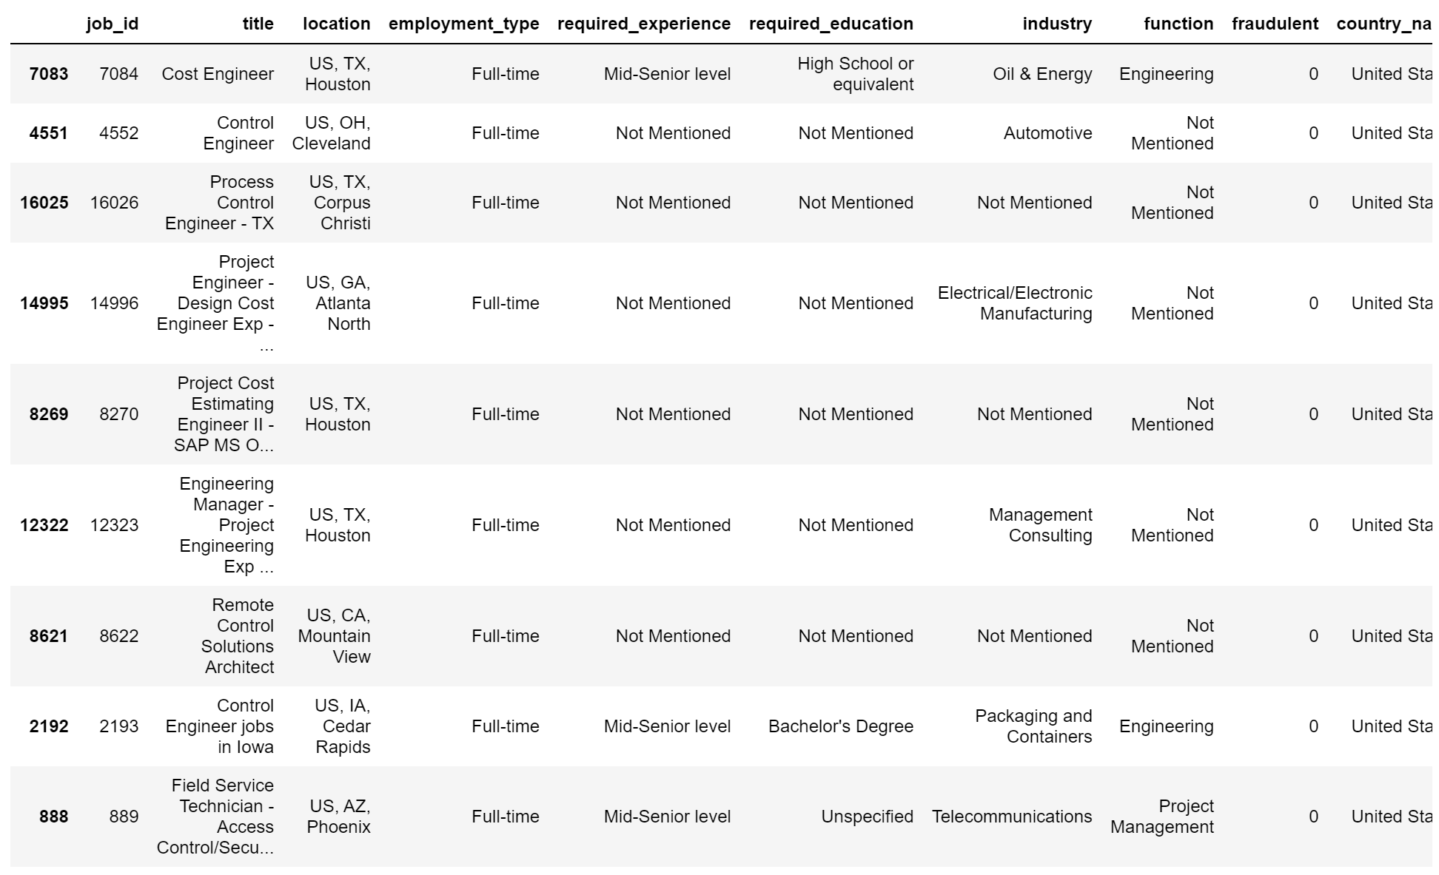
Recommendation System Results
25

Slide 26
References
https://towardsdatascience.com/fake-job-predictor-a168a315d866
https://www.analyticsvidhya.com/blog/2020/08/recommendation-system-k-nearest-neighbors/
26

Slide 27

27

